Slide 1
Welcome to the launch of
Spring Catalog 2024

Slide 2
Something BIG is coming your way
YOU are our privileged partners that help grow the Tupperware Brand
Brand News! You may soon start recognizing certain brand elements that are evolving
Sneak-Peek of a bigger Brand Story coming soon

Slide 3


Slide 4
Spring Catalog : dates
Dec 28, 2023 – April 24, 2024
Open for Sampling
  BL's and Directors : Nov 28th
  All SF : Dec 12th
Open for Parties : Dec 28th

Slide 5
Agenda
Product Mix
Theme & Pictures
New Products
Testimonials & Back Cover
Top Sellers
Go To Market Support
Sampling, Out list / New Products
Catalog Prices

Slide 6
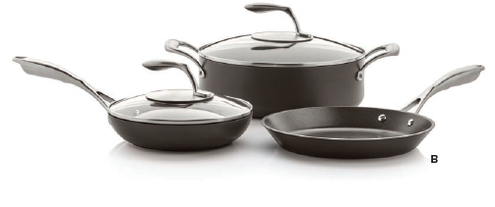
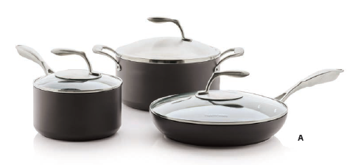
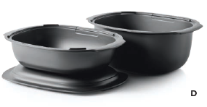
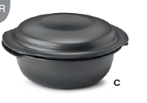
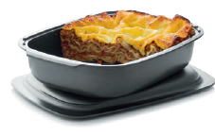
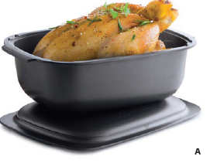
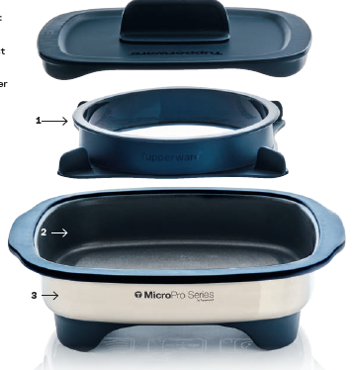
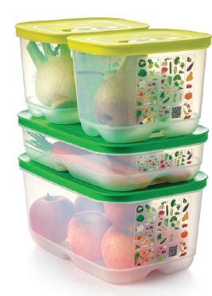
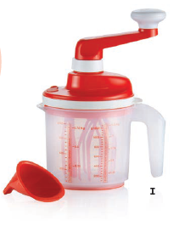
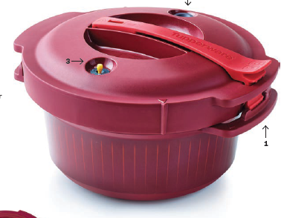
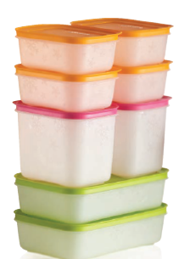
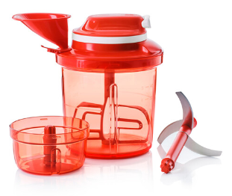
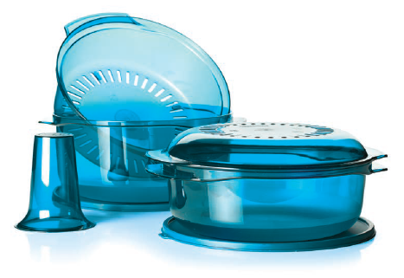
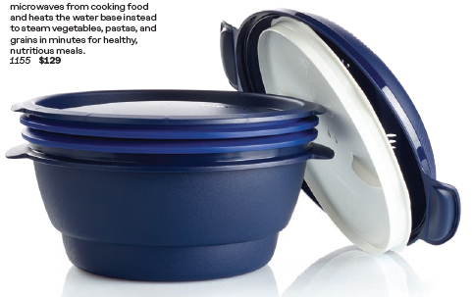
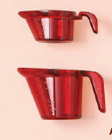
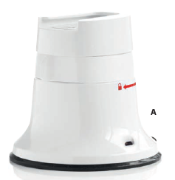
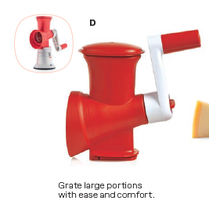
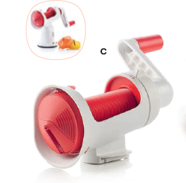
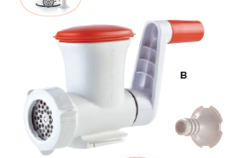
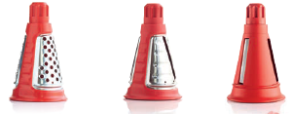
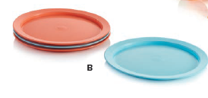
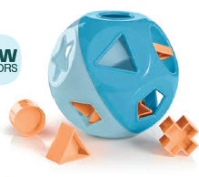
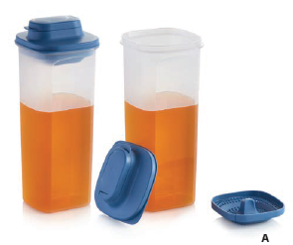
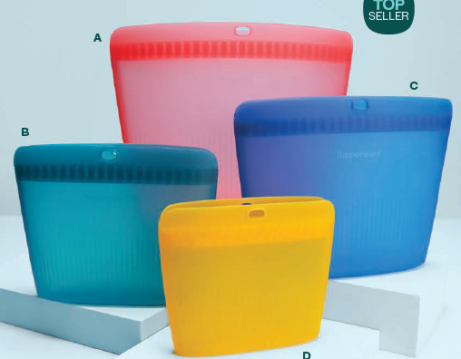
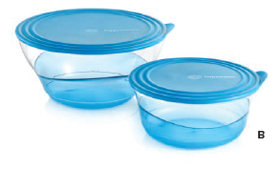
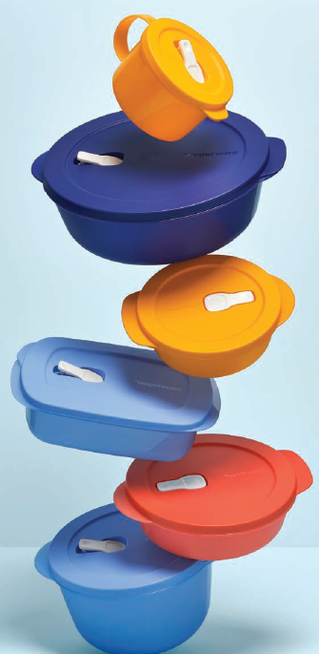
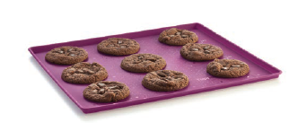
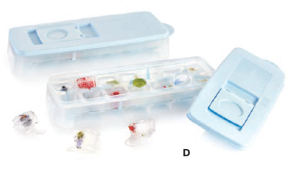
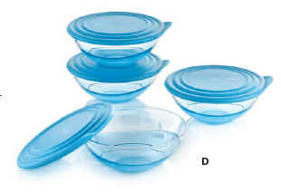

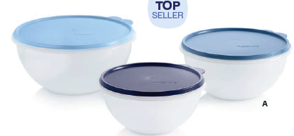
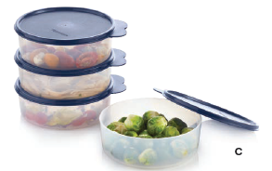
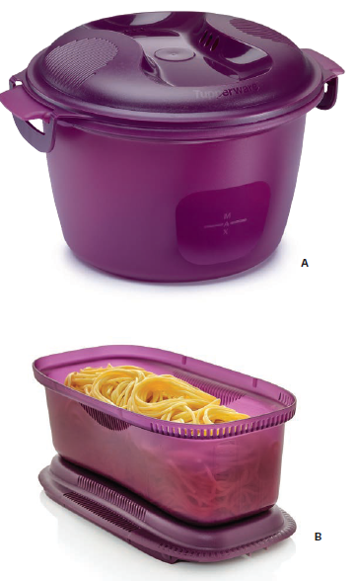
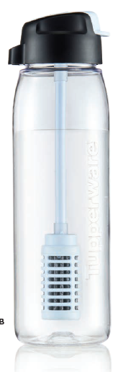
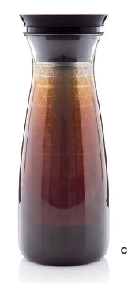
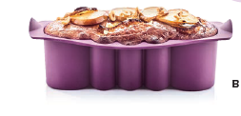
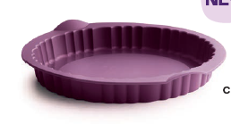
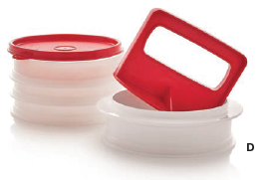
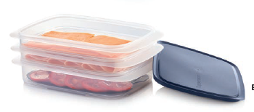
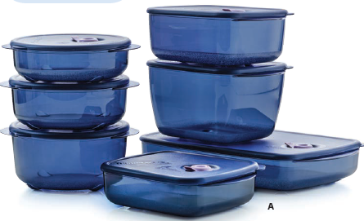
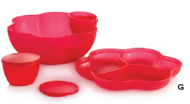
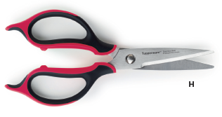
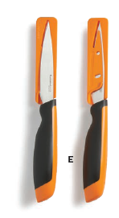
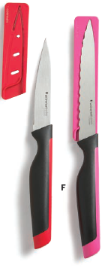
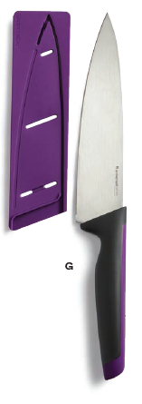
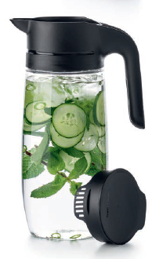
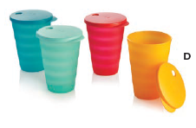
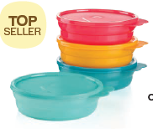
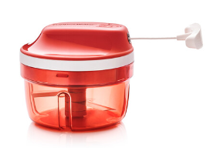
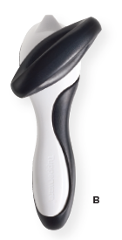
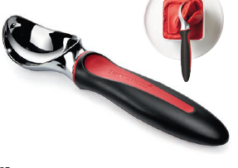



















































Product Price Mix
Best
17%
$ 60- more
$ 80- more
Better
30%
$ 40- $79
$ 30- $59
Good
53%
$ 0- $29
$ 0- $39
USA
CA

Slide 7
Agenda
Product Mix
Theme & Pictures
New Products
Testimonials & Back Cover
Top Sellers
Go To Market Support
Sampling, Out list / New Products
Catalog Prices

Slide 8



Catalog Theme
We are very excited to open the year 2024 with the theme Every Day Amazing
Since 1946 is has been truly Every Day amazing with Tupperware!
Every Day Amazing with Tupperware
Every day amazing journey since 1946.
Eating healthy
Cooking your favorite dishes
Have great products
Reduce single-use containers
Share the table with your family
Have opportunities to grow

Slide 9
Catalog Launch Video
Let's watch it together!!

Slide 10

New Picture style
We’re building a brand that puts our products and usage front and center.
Our photography style celebrates the beauty of using our products through:
colorful joy and energy,
simple composition,
and natural lighting that shows off our products to full effect.
Minimalist, modern photography showcases product features, usage, and ingredients, without any distractions.

Slide 11





Slide 12
Agenda
Product Mix
Theme & Pictures
New Products
Testimonials & Back Cover
Top Sellers
Go To Market Support
Sampling, Out list / New Products
Catalog Prices

Slide 13
So what's new in the catalog?
NEW COLORS
10
BRING BACK
13
HOST OFFER
2
NEW PRODUCTS
8

Slide 14




NEW COLORS
Ultra Clear
New color seal
New sizes
Great performance on the short term offer
2 great modular sets available
NEW PRODUCTS
Tupperware® Ultra Clear Oval 7pc Set
Item 319
US: $94
CA: $125
Tupperware® Ultra Clear Square 5-Pc. Set
Item 323
US: $92
CA: $124

Slide 15

Ultra Clear Squares
Product Feature | Related Benefit
New sizes | Large sizes offer a complete solution to storage needs: 3 ¼-cup/ 825ml 7-cup/ 1.7L 15-cup/3.6L
Airtight seal | Maintains freshness and keeps humidity, dust and bugs outside
Easy to open seal | The design of the seal with a prominent tab makes it easy to open. Also, the tab is wide enough to place a label on it.
High transparency | Identify contents at-a-glance
Stackable and Modularity | The square shape make these space-saving and ideal for the kitchen.

Slide 16




Slide 17





Eco+ Sandwich Keepers
Item 597
CA: $21
Eco+ Small Bottle
Item 561
CA: $8
Eco+ Lunch It Containers
Item 598
CA: $26
Eco+ Medium Bottle
Item 562
CA: $11
Eco+ Lunch It Large Container
Item 595
CA: $21
Eco+ Large Bottle
Item 563
CA: $14
NEW COLORS
BRING BACK
NEW COLORS

Slide 18



Super Snack 10-Pc. Set
Item 583
CA: $35
NEW COLORS
Salad On the Go Set
Item 590
CA: $27
NEW COLORS

Slide 19

Color continuity
Great impact of the color change of the kids category
Kids & Toys color harmonization

Slide 20

Shape-O Toy
Shape-O® Toy
Item 1399
US: $36
CA: $48
NEW COLORS

Slide 21


Slide 22

KP-Tools
All KP- Tools back as individuals
Mini Grater an Exclusive to the Pro Set

Slide 23







Spatula
Item 1278
CA: $12
Ladle
Item 1285
CA: $15
Scoop N Drain
Item 1264
CA: $15
Metal Whisk
Item 1274
CA: $24
Tongs
Item 1277
CA: $19
Serving Spoon
Item 1282
CA: $15
Silicone Spatula
Item 1304
CA: $24

Slide 24

Chef Series
Chef Series II 12"/30 cm Griddle is back
CA: $285
BRING BACK
Chef Series​
Opening date differed to beginning of February 2024​

Slide 25

Chef Series​
Opening date differed to beginning of February 2024​

Slide 26

Sandwich Spreaders
CA: $15

Slide 27

New Silicone Forms
Silicone Loaf Form
CA: $50
Silicone Tart Form
CA: $50
Silicone Ring Form
CA: $50

Slide 28



Silicone Baking Forms
Product Feature | Related Benefit
Long-lasting | Durable and will not deform in domestic use.
Designed for convenience | Two forms (Ring and Loaf Forms) fit on one oven rack.
Durable material | Flexible silicone for easy unmolding.
Versatile | Silicone Baking Forms can be used in the fridge, freezer, oven and microwave.
Loaf Form | Great for baking cake, breads or making ice cream cakes in the freezer.
Ring Form | Ideal for making baked donuts or overfill each cavity for a mini bundt shape.
Tart Form | Best for making tarts, quiche or pizza.

Slide 29
Quiche, Donut – High Hopes Video
https://youtu.be/bupzkHgBfnc?si=jERVICk_XBHSwhwb

Slide 30


New Serveware
Clearly Elegant Dispenser
CA: $19
Clearly Elegant Large Dispenser
CA: $26

Slide 31

Clearly Elegant Dispensers
Top Cap- has a one-handed opening system to allow for easy opening and closing of cap.
Silicone Plug- For an easy and tight closure.
Glossy Surface- Indicates where to press to open the cap.
Drip Free Spout- Allows for easy, controlled pouring and prevents messy drips and spills
Ribs on the Cover- Help to have a good grip.
Vent Cap- Makes pouring experience smooth and mess-free by providing an air channel
Silicone Gasket- Provides a watertight closure between the cover and base.
Large Opening- Practical and convenient for easy refilling without spilling when cover is unscrewed.

Slide 32



New Host
Now it's easier to organize!!!
Modular Mates Round 1s
US: $10
Tupperware® Signature Line Storage Set
US: $226

Slide 33

Signature Line Storage Set
Product Features | Related Benefit
Hinged clear cover | Features a full width tab to lift open easily. Cover stays open when gently pushed back then press to snap closed.
The black ring on the rim | Fits to ensure a firm closure and it adds an elegant trim detail.
Wide opening | Useful for quick grab and go.
Ridges on the top | Allow the containers to stack securely.

Slide 34
Agenda
Product Mix
Theme & Pictures
New Products
Testimonials & Back Cover
Top Sellers
Go To Market Support
Sampling, Out list / New Products
Catalog Prices

Slide 35



Slide 36



Slide 37

Back cover is focused on the recruiting

Slide 38

Front Cover

Slide 39
Agenda
Product Mix
Theme & Pictures
New Products
Testimonials & Back Cover
Top Sellers
Go To Market Support
Sampling, Out list / New Products
Catalog Prices

Slide 40









Top Sellers
New Color, New Product and New Top Seller
Continue as Top Sellers

Slide 41
Agenda
Product Mix
Theme & Pictures
New Products
Testimonials & Back Cover
Top Sellers
Go To Market Support
Sampling, Out list / New Products
Catalog Prices

Slide 42




Catalog Design Awards
3 products own this Award.
2 products own this Award.

Slide 43


Catalog QR Codes
More than 14 QR codes with videos that explain and describe how our products are used, such as the Super “Portioning Scoops, Jel Party and more…”

Slide 44
Marketing Support
Still Life Images
Dec 28th
Life Style Images
Dec 28th
Product Videos
Dec 28th
Recipes
Nov 28th
TuppSocial Assets
Dec 28th

Slide 45
Agenda
Product Mix
Theme & Pictures
New Products
Testimonials & Back Cover
Top Sellers
Go To Market Support
Sampling, Out list / New Products
Catalog Prices

Slide 46
Sampling
Item | Description | Sampling BL & Directors Open Date | Sampling ALL SF Open Date | Sampling Closing Date
590 | Clearly Elegant® Large Dispenser | 28-nov | 12-dic | 05-abr
583 | Eco+ Lunch-It® Large Container | 28-nov | 12-dic | 05-abr
561 | Eco+ Sandwich Keepers | 28-nov | 12-dic | 05-abr
562 | Salad On the Go Set | 28-nov | 12-dic | 05-abr
563 | Super Snack 10.pc Set | 28-nov | 12-dic | 05-abr
316 | Eco+ Bottle Small | 28-nov | 12-dic | 05-abr
317 | Eco+ Bottle Medium | 28-nov | 12-dic | 05-abr
318 | Eco+ Bottle Large | 28-nov | 12-dic | 05-abr
320 | Tupperware 2-cup/500 mL Oval*® Ultra Clear | 28-nov | 12-dic | 05-abr
321 | Tupperware® Ultra Clear 41/2-cup/1 L Oval* | 28-nov | 12-dic | 05-abr
322 | Tupperware® Ultra Clear 91/2-cup/2.2 L Oval* | 28-nov | 12-dic | 05-abr
1399 | Tupperware® Ultra Clear 31/4-cup/825 mL Square | 28-nov | 12-dic | 05-abr
8789 | Tupperware® Ultra Clear 7-cup/1.7 L Square* | 28-nov | 12-dic | 05-abr
7409 | Tupperware® Ultra Clear 15-cup/3.6 L Square* | 28-nov | 12-dic | 05-abr
487 | Shape-O ® Toy | 28-nov | 12-dic | 05-abr
489 | Modular Mates Round 1s | 28-nov | 12-dic | 05-abr
488 | Tupperware® Signature Line Storage Set | 29-nov | 12-dic | 05-abr
432 | Silicone Ring Form | 26-dic | 12-dic | 05-abr
595 | Silicone Loaf Form | 26-dic | 12-dic | 05-abr
597 | Silicone Tart Form | 26-dic | 12-dic | 05-abr
598 | Eco+ Lunch-It® Containers
895 | Chef Series II 12"/30 cm Griddle
To be confirmed

Slide 47

Out List

Slide 48



Slide 49


Slide 50
New Products
&
New Colors

Slide 51


Slide 52
Agenda
Product Mix
Theme & Pictures
New Products
Testimonials & Back Cover
Top Sellers
Go To Market Support
Sampling, Out list / New Products
Catalog Prices

Slide 53
Catalog Prices
PRINTED CATALOGS:
Catalogs available individual pack of 10 and carton of 14 packs
Printed Catalog prices / Individual: CA $ 1.30
Printed Catalog prices / Pack of 10: CA $ 10.80
Printed Catalog prices / Carton of 14 packs: CA $ 130

Slide 54

Open for Sampling BL´s | Nov– 28th
Open for sampling (All) | Dec-- 12th
Open for sales | Dec – 28th

Slide 55
Let's have a look at
the Spring Catalog

